Slide 1
Journey presentation Foundation and generic
Week 1: 14/08/23 – 18/08/23
Meghna Sabharwal
Associate data engineer

Slide 2


Day 1
Introduction
Code of conduct at workplace
Know your colleagues
Team activities
Formal communication
Group activities

Slide 3
Day 2
Video call, phone call and chat etiquettes at workplace
Team activities
Building trust and sense of empathy amongst colleagues
Trust building activities
How to work as a team

Slide 4
Day 3
Importance of team work
Team activities
Leadership styles and importance with demonstration
Stakeholder identification
Skills to enhance technical presentation

Slide 5

Day 4
Defining business
Introduction to business analysis
Requirement analysis
Mandatory requirements i.e. Functional requirements
Non-functional requirements
SDLC model and its phases
Different requirements elicitation techniques
What is requirement modelling and its types
Different requirement management skills
Detailed information about waterfall model and agile model
Introduction to scrum, Its advantages and disadvantages
Introduction to Azure
Copyright of Shell International B.V.

Slide 6
Week 2
Copyright of Shell International B.V.

Slide 7
Day 1
Defining business
Introduction to business analysis
Requirement analysis
Mandatory requirements i.e. Functional requirements
Non-functional requirements
SDLC model and its phases
Different requirements elicitation techniques
What is requirement modelling and its types
Different requirement management skills
Detailed information about waterfall model and agile model
Introduction to scrum, Its advantages and disadvantages
Introduction to Azure
Copyright of Shell International B.V.

Slide 8
Day 2
Introduction to DBMS
Introduction to SQL
Difference between SQL and NOSQL
Different forms of normalisation
Introductions to joins and its types
Demonstration of SQL queries
Copyright of Shell International B.V.

Slide 9
Day 3
Software testing
Importance of software testing
Software testing models
Difference between SDLC and STLC
Different types of testing
Introduction to black-box, white-box and grey-box testing
Unit testing
Integration testing
BDD
Copyright of Shell International B.V.

Slide 10
Day 4
DevOps
DevOps lifecycle
DevOps tools
DevOps strategies
CI CD
Copyright of Shell International B.V.

Slide 11
Day 5
Introduction to Github
Introductions of Azure DevOps
Creating virtual machine on Azure
Create Github actions
Copyright of Shell International B.V.

Slide 12
Week 3
Copyright of Shell International B.V.

Slide 13
Day 1: Case study
Case study – Created a projects on devOps, created sprints, epics, backlogs testcases etc.
Created virtual machine on the azure
Performed GitHub activities
Performed maven activities
Created docker file
Completed Prometheus activities
Created and deployed web application on the azure
Copyright of Shell International B.V.

Slide 14
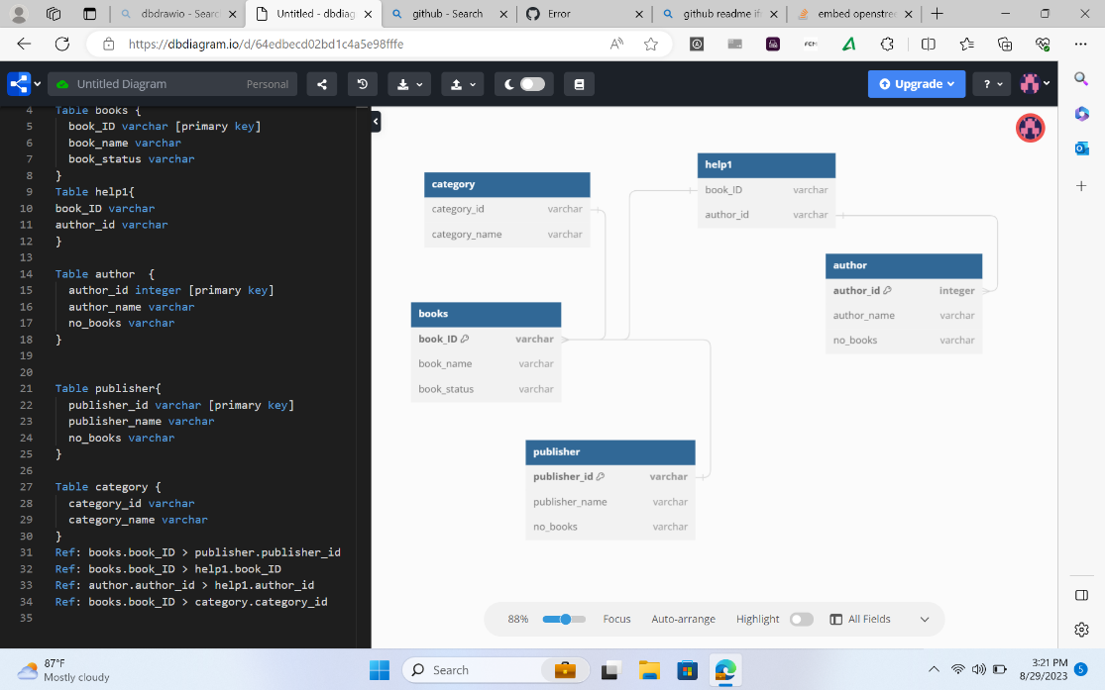
Day 2: Basics of business intelligence
What is Business intelligence
KRA and KPI
Dimension modelling
Data warehouse
DSS
Designed a model for library system
Copyright of Shell International B.V.

Slide 15
Day 3: Big data and Azure fundamentals
Hands on dimension modelling on library system
Introduction to OLAP
Types of OLAP
Introduction to MOLAP
Introduction to ROLAP
Introduction to HOLAP
Introduction to COLAP
Introduction to slicing and dicing
Copyright of Shell International B.V.

Slide 16
Day 4: Azure SQL
Hands on SQL
Created an SQL database on Azure
Created tables in the database
Performed various joins in SQL
Extracted the information from different tables in SQL
Copyright of Shell International B.V.

Slide 17
Day 5: Azure SQL
Assessment for basic SQL
Hands on SQL
Assessment for hands on SQL
Copyright of Shell International B.V.

Slide 18
Week 4
Copyright of Shell International B.V.

Slide 19
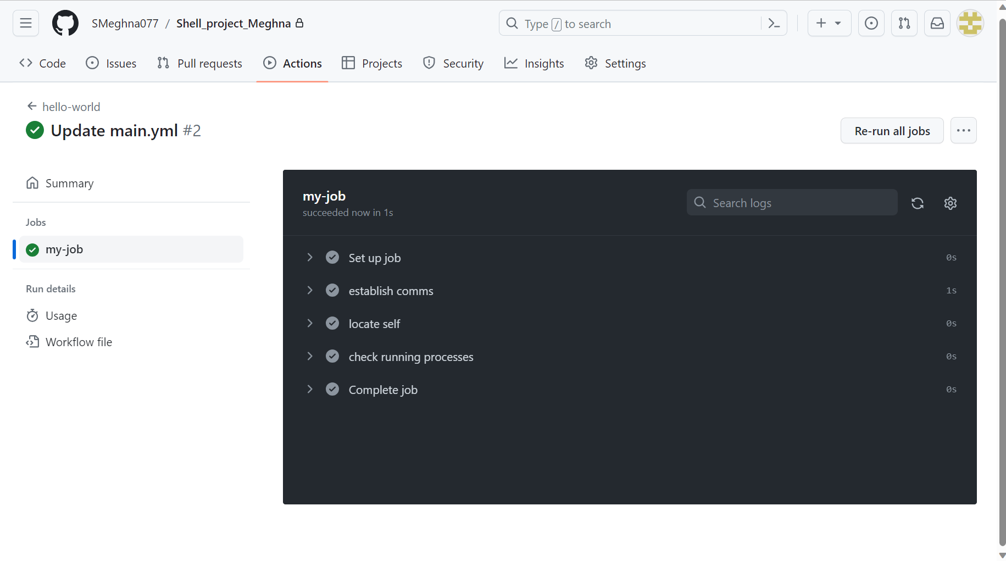
Day 1
Learnt different storage types in SQL
Learnt different resources in the SQL
Copyright of Shell International B.V.

Slide 20
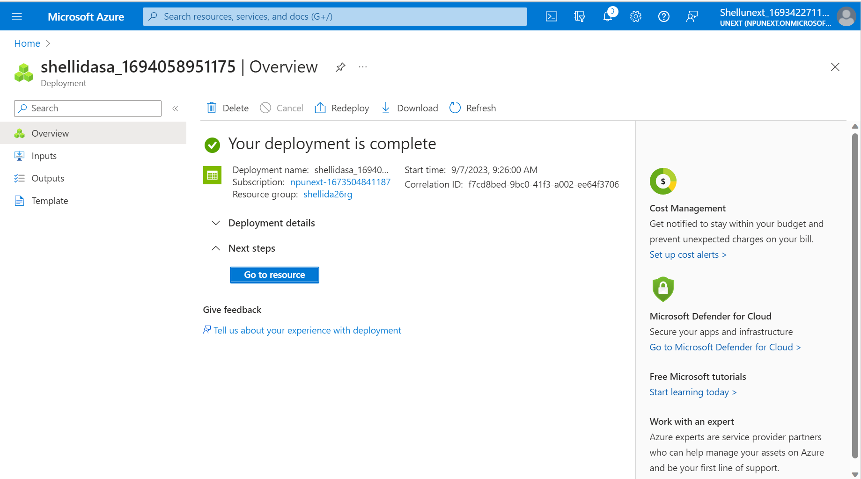
Day 2
Created different storage like blob and ADLS2 on azure
Copyright of Shell International B.V.

Slide 21
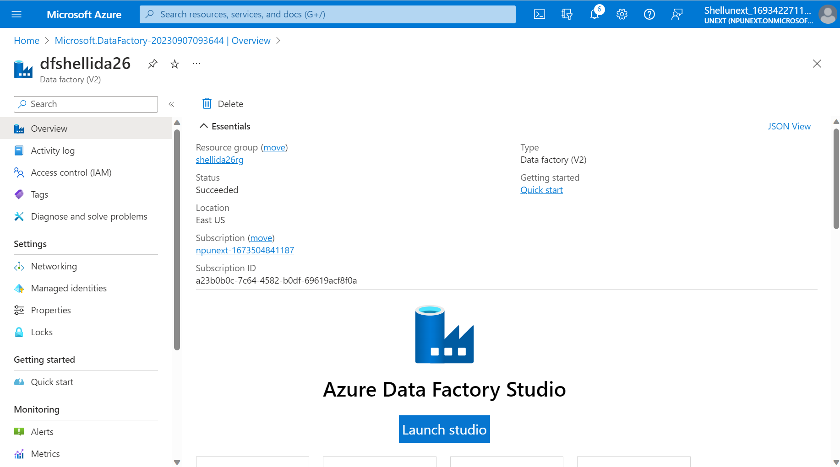
Day 3
Created data flow in the Azure
Copyright of Shell International B.V.

Slide 22
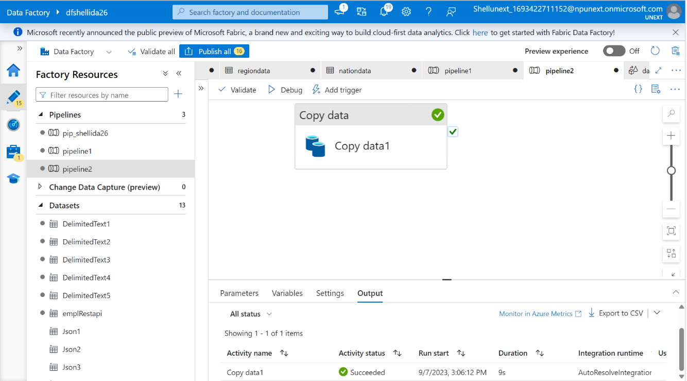
Day 4
Created different pipelines in the data factory
Created different Datasets in the Azure
Linked workflow with the datasets and files
Performed get metadata, for loop and if loop on the azure
Copyright of Shell International B.V.

Slide 23
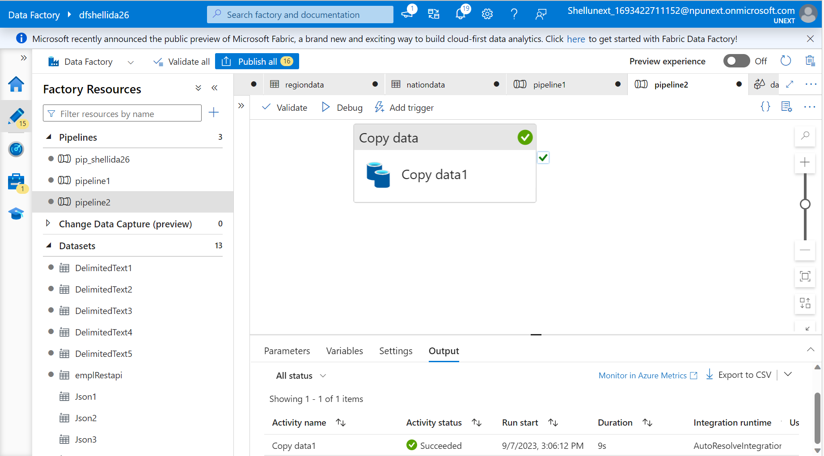
Day 5
Practiced hands on SQL and azure on the virtual machine
Created dataset offline and imported in the azure
Created database on the azure
Performed CDC on azure
Copyright of Shell International B.V.

Slide 24
Week 5
Copyright of Shell International B.V.

Slide 25
Day 1 -
Doubt Solving session
Repitation of Azure Data Factory
Hands-on on Azure Data Factory
loading the dataset into the storage account
Creation of pipeline
Fetching, updating rows of a table and getting affected in ADF and data storage
Creating the dataflow and CDC for the instances

Slide 26
Day 2 -
Azure Synapse Analytics
Introduction to Azure Synapse Analytics
Mapping of data flow
Creation of pipeline, Data Ingestion and Preparation
Write and execute SQL queries
Understanding query performance optimization technique
Exploring more options like manage, linked device creation
Explanation with theory and practical for all of the above concepts.

Slide 27
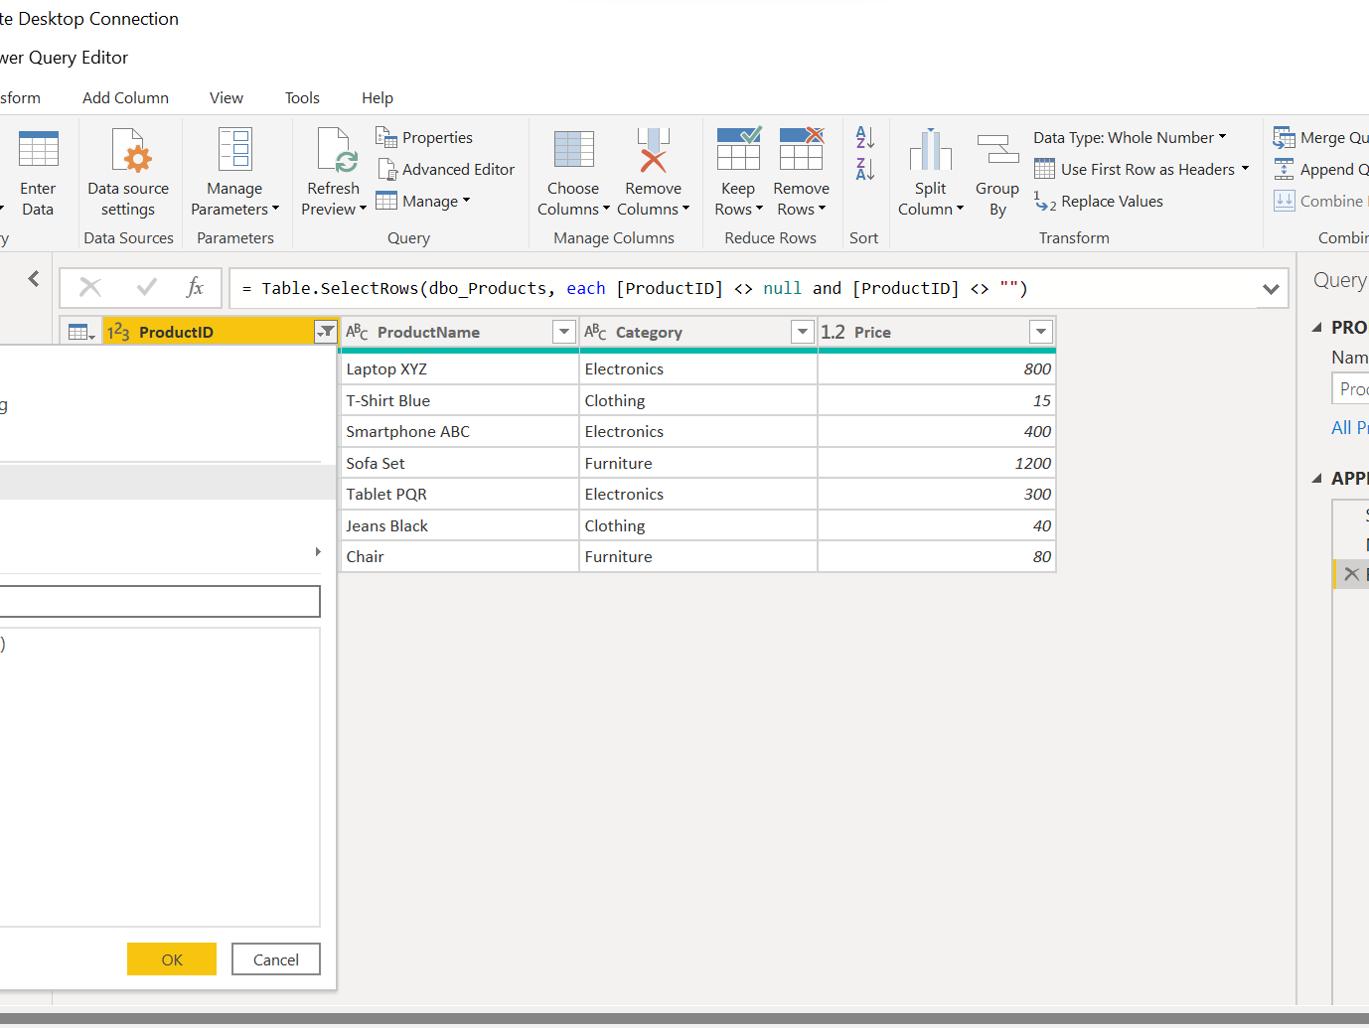
Day 3 -
Data Visualization using Power-Bi
Understanding and exploring about Power-Bi
Connecting to the various sources
Data load and transformation- removing duplicates, adding column, slicers, and group
Introduction to Dax and calculated column
Implicit and explicit measures
Row-level security and aggregation function

Slide 28
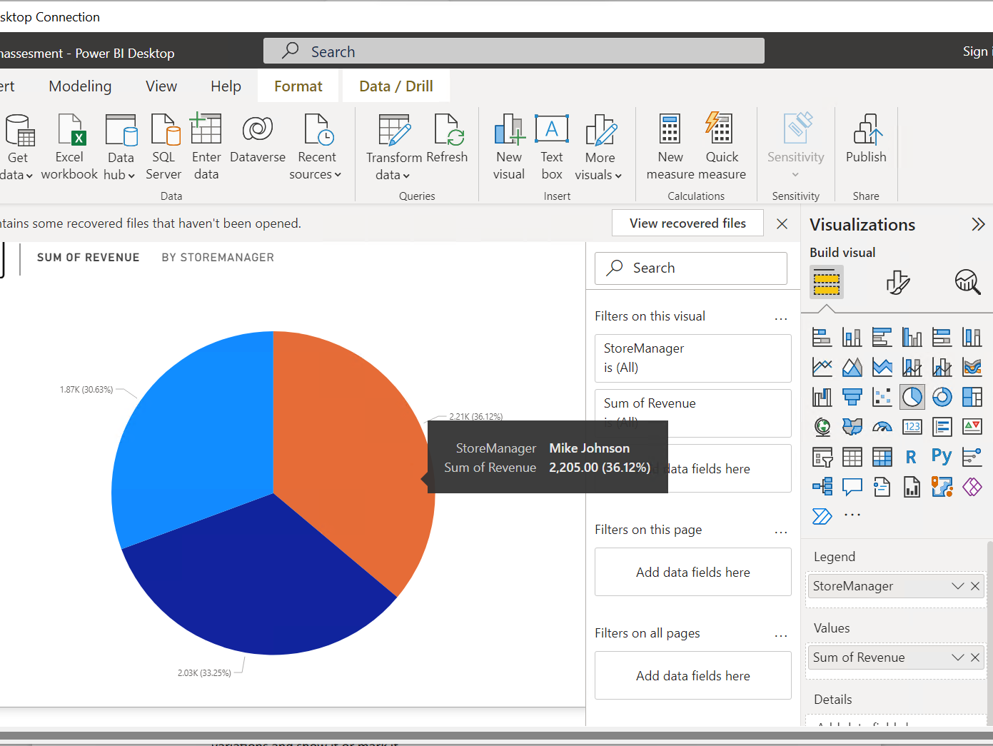
Day 4 -
Understanding various chart-type
Report and models
Dashboard
Hands-on
Recap
Scenario-based chart preparation

Slide 29
Day 5 -
Introduction to Python
Variables, data types
Features of python
Creating a small data set
Exploring functions like zip, enumerate
Working on Lists, Dictionary, for-loop

Slide 30
Week 6 19/09/23- 22/09/23
Copyright of Shell International B.V.

Slide 31
Day 1
Learnt advanced concepts of python
Knowledge about List Comprehensions and Lambda Functions
Introduction to Panda Data Frame
Understanding Positional and Keyword Arguments
Copyright of Shell International B.V.

Slide 32
Day 2
NumPy Array
A review on Dictionaries, Sets, Tuples and Map
Visualizing dataset using Matplotlib and Pandas
Copyright of Shell International B.V.

Slide 33
Day 3
Introduction to PySpark
Spark Architecture
Introduction to PySpark shell
RDD concepts overview
Copyright of Shell International B.V.

Slide 34
Day 4
Spark Caching
Spark and Fault Tolerance
RDD to Data frame
Copyright of Shell International B.V.

Slide 35
Week 7 23/09/23- 29/09/23
Copyright of Shell International B.V.

Slide 36
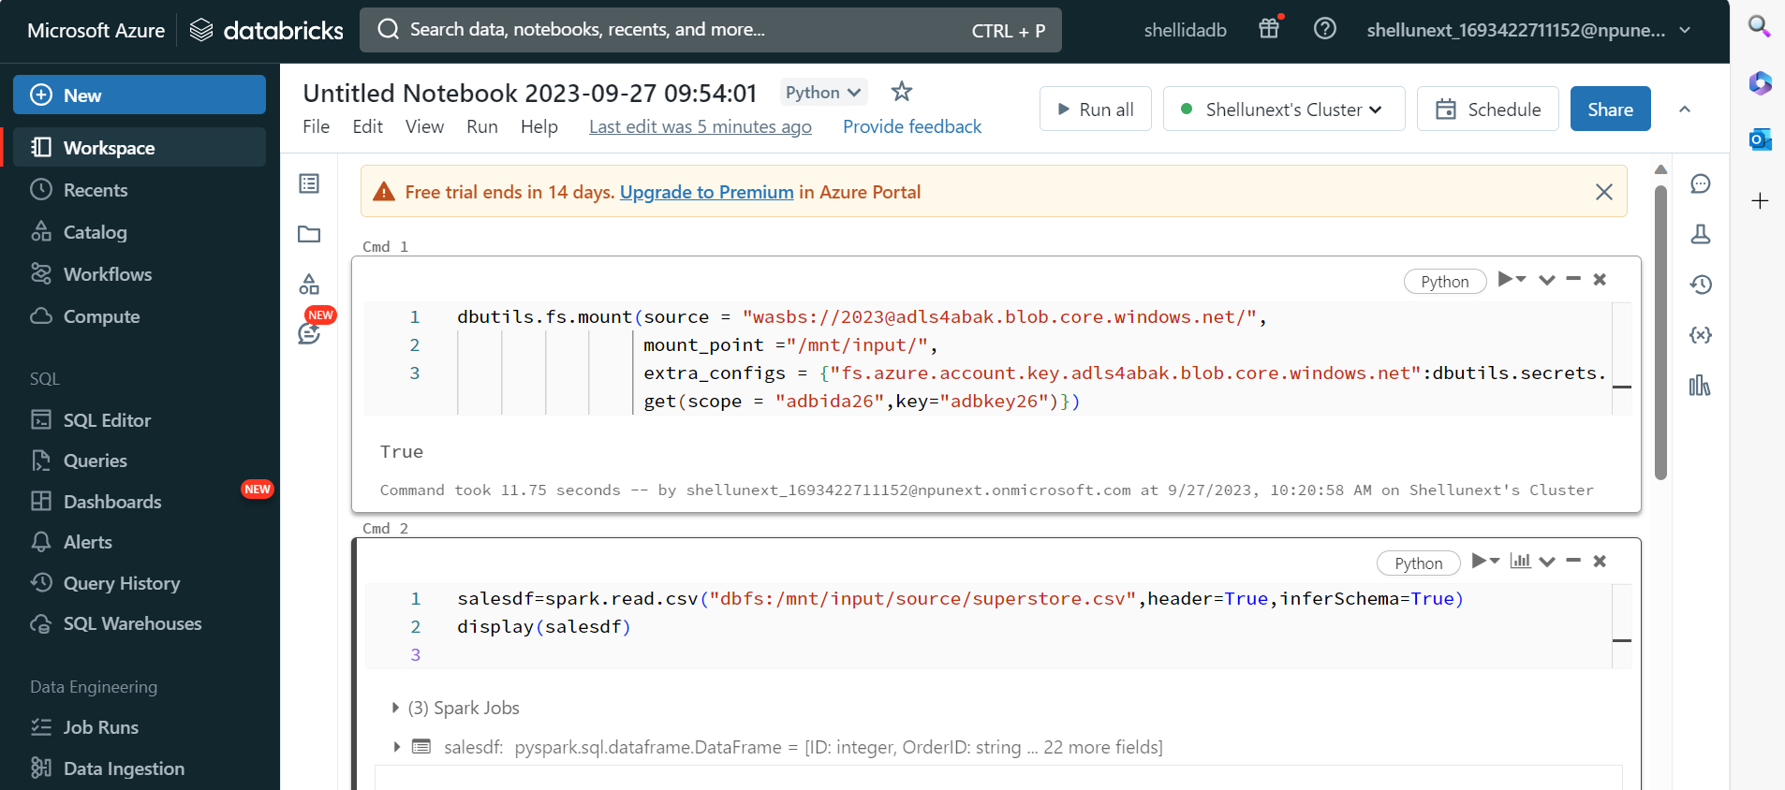
Day 1
Copyright of Shell International B.V.

Slide 37
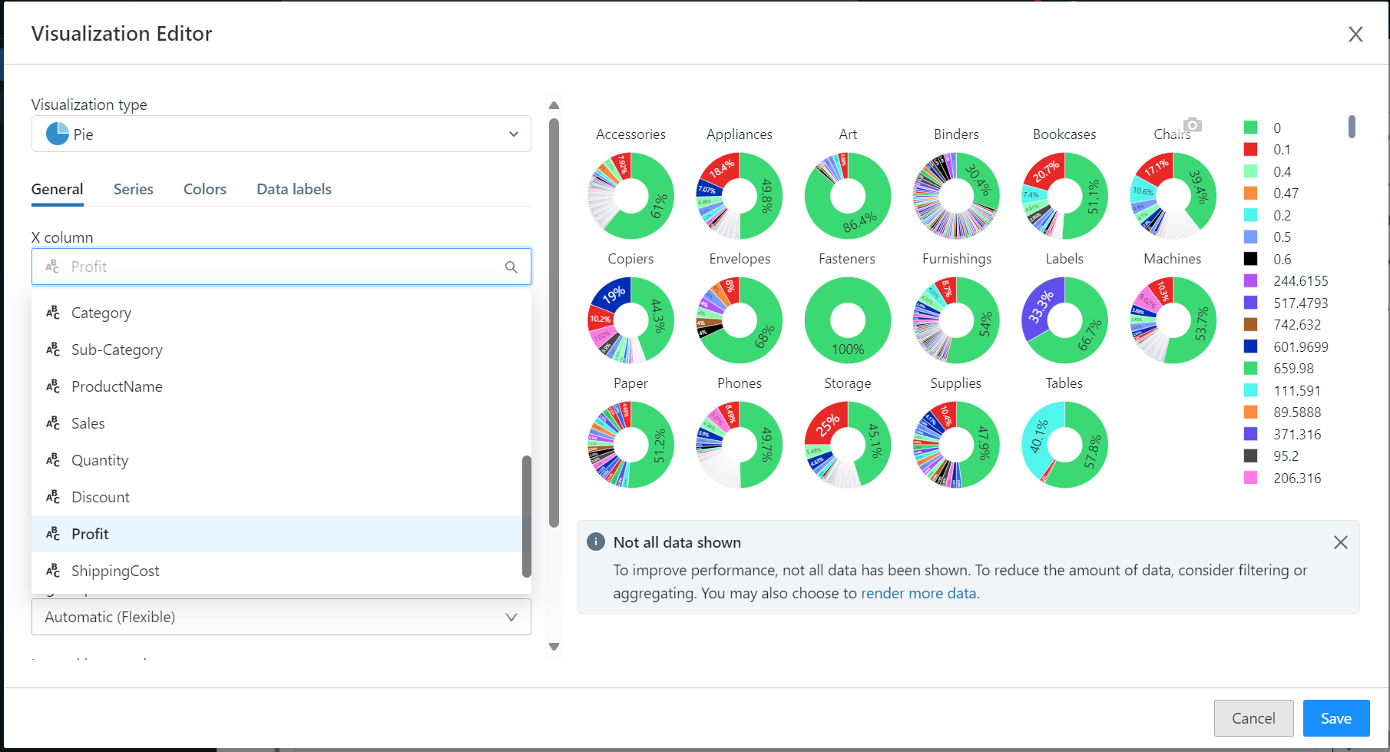
Day 2
Copyright of Shell International B.V.

Slide 38
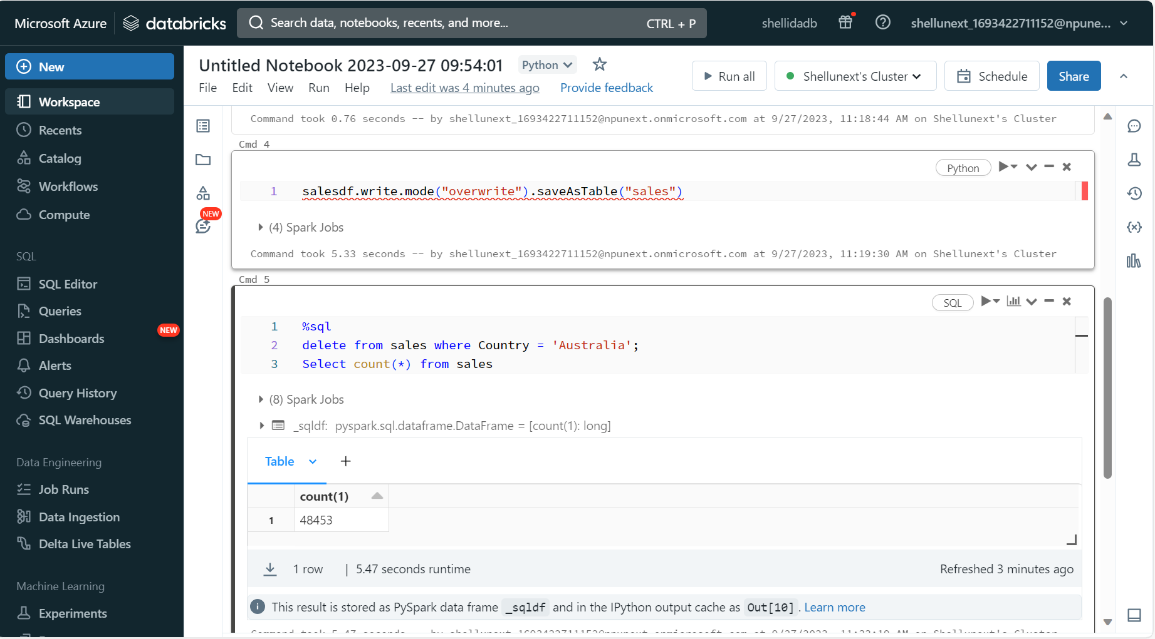

Slide 39
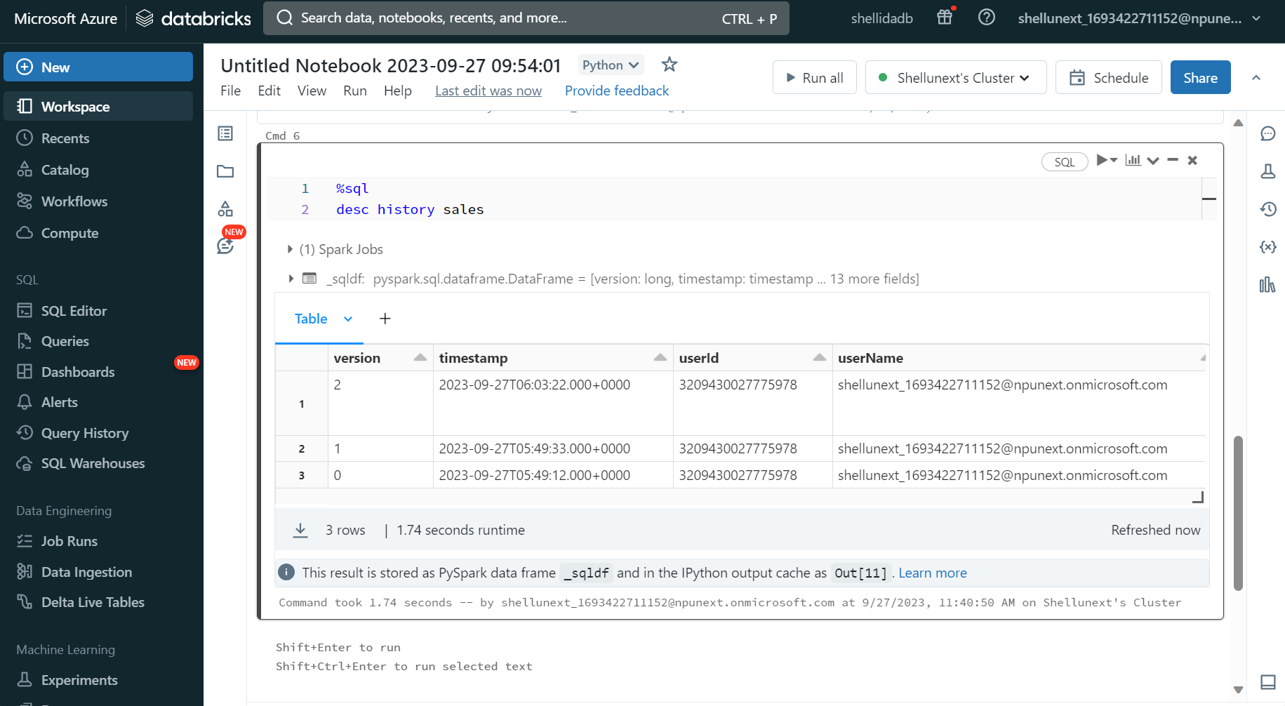
Day 3
Copyright of Shell International B.V.

Slide 40
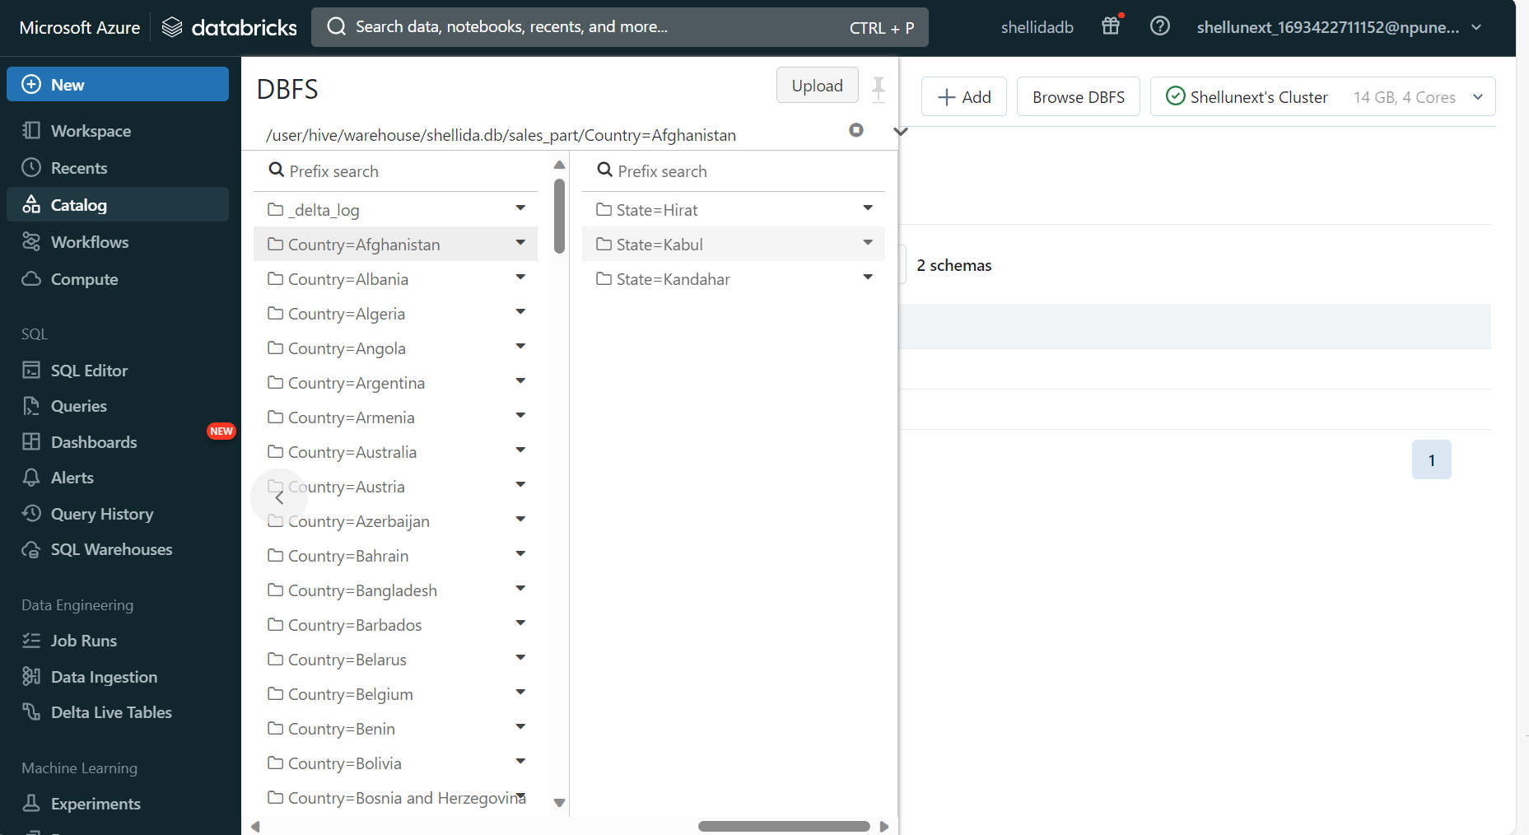

Slide 41
Day 4
Learnt the basic of Kubernetes
Learnt how to connect the azure to Kubernetes
Copyright of Shell International B.V.

Slide 42
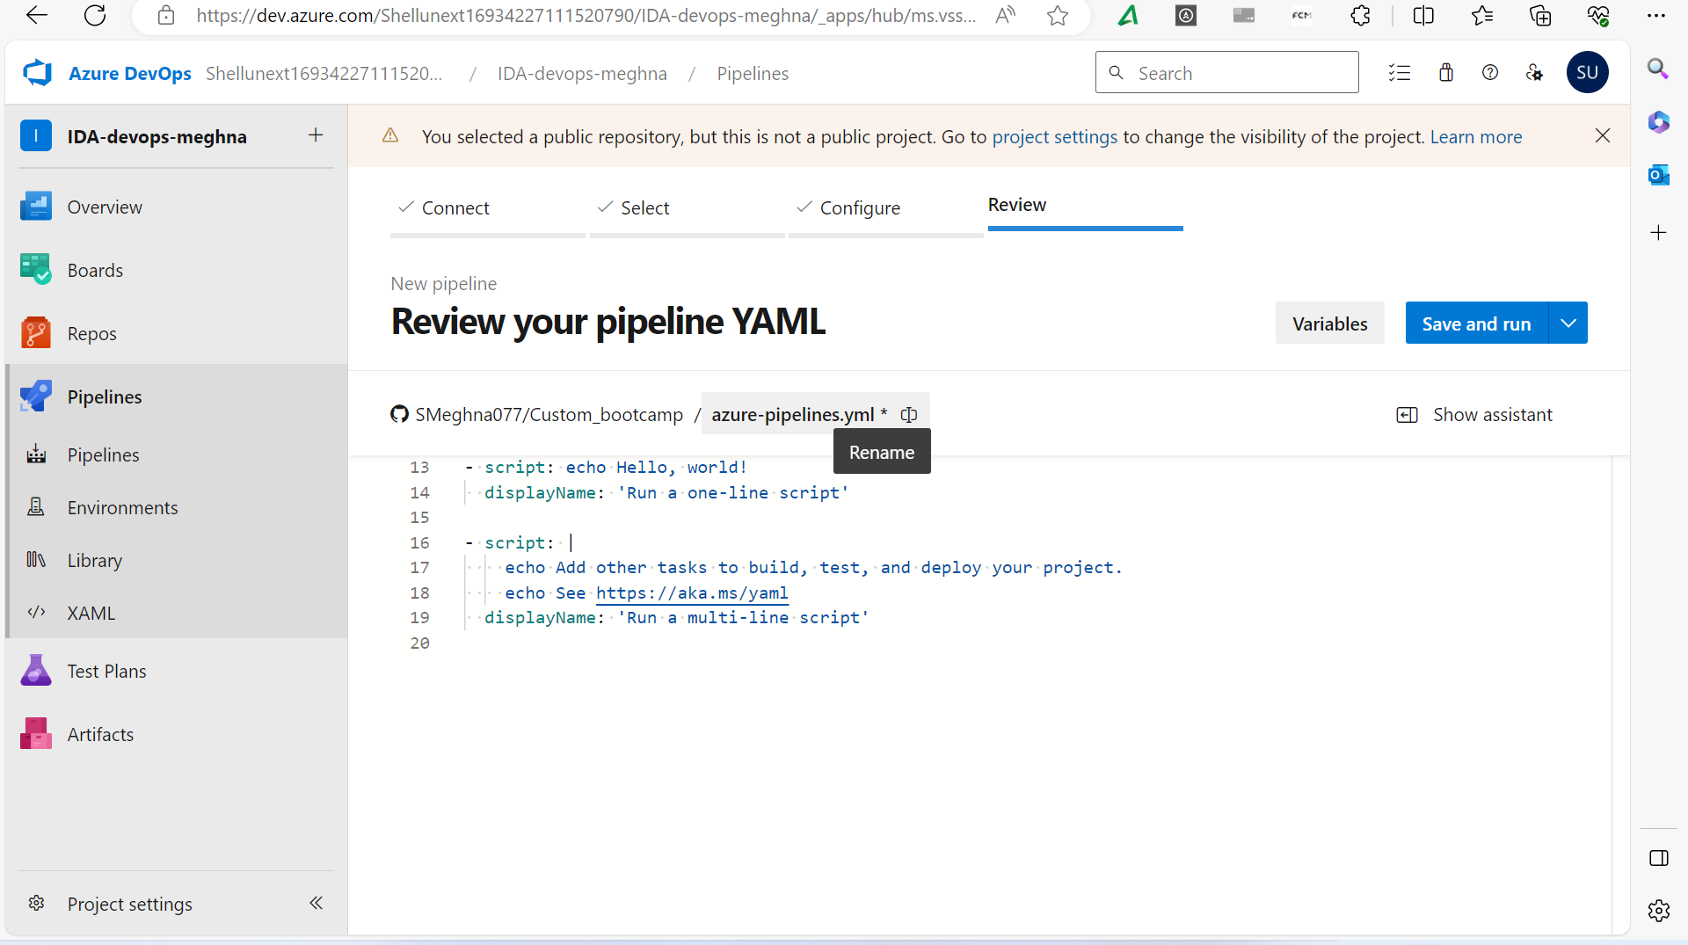
Day 5
Copyright of Shell International B.V.

Slide 43
